Slide 1
Modeling Capabilities of Digital Twin Platforms – Old Whine in New Bottles?
ECMFA@STAF ‘22
Jérôme Pfeiffer¹,
Daniel Lehner²,
Andreas Wortmann¹,
Manuel Wimmer²
1 Institute for Control Engineering of Machine Tools and Manufacturing Units, University of Stuttgart, Germany
2 CDL-MINT, Institute for Business Informatics - Software Engineering, Johannes Kepler University Linz, Austria
Notes:
Hello everybody
Name
research assistant at university of Stuttgart
Present an extension to our SCOLAR framework towards <title>

Slide 2
Motivation
Digital Twins (DTs) monitor and optimize cyber-physical systems (CPS)
Developing DTs requires collaboration between software experts and CPS experts
DT Platforms provide dedicated modeling languages to facilitate DT engineering
But: New concepts? Or existing concepts (old whine) wrapped in new textual syntaxes (new bottles)
RQ1: What are the conceptual metamodels used by existing DT platforms?
RQ2: How do they relate to existing modeling concepts and standards?
RQ3: How can existing modeling concepts be leveraged to enable portability?
Notes:
For successful mde we need useful modeling languages
However, engineering is challenging
→ Therefore, we believe that we …

Slide 3

Digital Twin Platforms
Microsoft Azure
DTDL
Provides JSON-like Digital Twin Definition Language (DTDL) to describe digital twins
Contextualizes raw data and acts as contract to other services
Querying of data from Azure’s cloud and external services to perform analysis and computation on received data
Visualization
1
2
3
4
5
6
7
8
9
10
11
12
13
14
15
16
17
18
19
{
"@id": "dtmi:com:example:Building;1",
"@type": "Interface",
"displayName": "Building",
"contents": [
{
"@type": "Property",
"name": "name",
"schema": "string",
"writable": true
},
{
"@type": "Relationship",
"name": "contains",
"target": "dtmi:com:example:Room;1"
}
],
"@context": "dtmi:dtdl:context;2"
}
https://azure.microsoft.com/en-us/services/digital-twins/

Slide 4
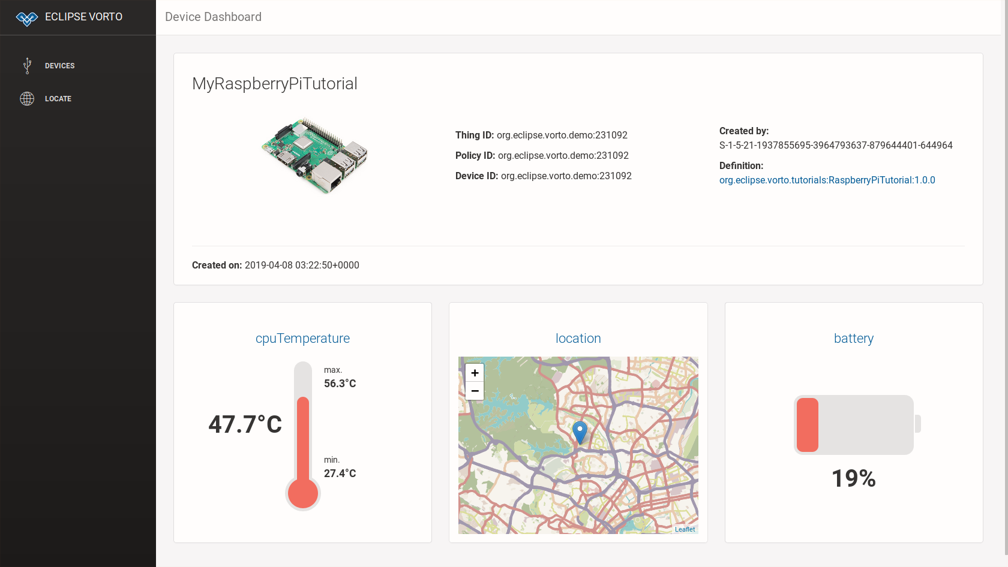

Digital Twin Platforms
Eclipse Foundation
Describe CPS with a digital model
Information models compose functionblocks into bigger components
Function block are reusable implementation parts that can define properties, operations, or events
Code generators translate models into applications
1
2
3
4
5
6
infomodel ECar{
functionblock {
battery as Battery
//…
}
}
1
2
3
4
5
6
functionblock Battery {
status {
mandatory remainingCapacity as Percentage }
}
https://github.com/eclipse/vorto/blob/master/docs/tutorials/create_webapp_dashboard.md
https://www.eclipse.org/vorto/

Slide 5
Digital Twin Platforms
Amazon Webservices IoT TwinMaker
Integrated into AWS environment
Components are a digital representations of elements in a digital twin (e.g., physical equipment, process)
provide context and data
components are defined by JSON models
Components and their relationships span a graph
Enables querying and visualization
1
2
3
4
5
6
7
8
9
10
11
12
13
14
15
16
17
{
"componentTypeId": "example.alarm",
"workspaceId": "MyWorkspace",
"isSingleton": false,
"propertyDefinitions": {
"alarm_status": {
"dataType": {
"type": "STRING"
"allowedValues": [
{
"stringValue": "ACTIVE"
},//...
],
}, //...
}
}
}
https://docs.aws.amazon.com/iot-twinmaker/latest/guide/twinmaker-component-types-examples.html

Slide 6
RQ1: Uncovering DT Platform Metamodels
Microsoft Azure DTDL
Interface: type of physical asset
Commands: interaction with devices
Telemetry: continuous data streams
Properties: not frequently changing
Relationship: association to interfaces
Component: composition of interfaces
DTMI
1
0..2 extends
1 schema
Interface
DTElement
1 target
InterfaceContent
Command
Telemetry
Property
*
Relationship
Component
1
1
Schema
Object
Map
GeospacialSchema
InterfaceSchema
Array
Enum
PrimitiveSchema

Slide 7
RQ1: Uncovering DT Platform Metamodels
Eclipse Vorto
InformationModels: Aggregate Function-Blocks into bigger components
FunctionBlocks: Reusable implementation parts that contain events, operations, or properties
Event: a list of properties with timestamp
Operation: interaction possibilities with the described asset
Property: attribute of function block
InformationModel
*
FunctionBlockProperty
superType
0..1
0..1 type
FunctionBlockModel
FunctionBlock
0..1 extended FunctionBlock
*
*
status *
* fault
* config
Event
Operation
Property
*

Slide 8
RQ1: Uncovering DT Platform Metamodels
AWS IoT TwinMaker
ComponentType: defines a type of assets
Function: reference a function to interact with the described assets
PropertyDefinition: Defines properties, i.e., attributes of the component
DataType: type of properties
Relationship: associations between component types
[0..10] extendsFrom
ComponentType
*
Function
0..1 target
*
required Properties
Property Definition
*
nestedType
1
DataType
0..1
0..1
Relationship

Slide 9
RQ2: How do they relate to existing modeling concepts and standards?
A comparison with concepts of object-orientation
OOM Concepts (UML CD) | DTDL Metamodel | Vortolang Metamodel | TwinMaker Metamodel
Class | Interface | FunctionBlock | ComponentType
Property | Property | Property | PropertyDefinition (isTimeSeries=true)
Temporal Property | Telemetry | Event | PropertyDefinition (isTimeSeries=false)
Association | Relationship | - | PropertyDefinition. DataType. Relationship
Method | Command | Operation | Function
Composition | Component | Function BlockProperty

Slide 10
RQ3: How can existing modeling concepts enable portability
Extending UML CD to DTUML
Using UML CD as a pivot
Extending UML CD with a profile
Differentiate between:
Shared platform concepts
Platform-specific concepts
Transform between platforms
Reduce transformations from n•(n-1) to 2•n
Profile DTUML
«Stereotype»
DTProperty
Boolean isTimeSeries
String unit
String type
«Metaclass»
Property
Int lowerBound
«Stereotype»
VL_Property
«Stereotype»
DTDL_Property
«Stereotype»
TM_Property
Boolean isFault
String constraintRule
String type
Boolean isExternalId
Boolean isStoredLocally
List<String> allowedValues

Slide 11
RQ3: How can existing modeling concepts enable portability
Demonstration Case for portability between DTDL and TwinMaker
«TMClass»
{isSingleton = true} Building
*
Robot
«DTDLClass» {displayName = „Temperature Sensor“} TemperatureSensor
*
String type
String value «DTProperty» {
isTimeSeries = true
unit = „degreeFahrenheit“}, «DTDLProperty»{
quantity = „Temperature“}
*
1
Room
*
Controller
Int aqLevel «DTProperty» {
isTimeSeries = true }
1
«DTDLClass»
{displayName = „ CO₂ Sensor“}
CO2Sensor
Alarm
*
*
Boolean isActive
String type
String value «DTProperty» {
isTimeSeries = true
unit = „ppm“ }
«DTDLClass»
{displayName = „Ventilation System“}
VentilationSystem
Notes:
Scenario:
Robots with controller and attached temperature and CO2 sensor drives around rooms and can give an alert whenever a certain threshold is passed.
Rooms can then activate their ventilation system to improve air quality
Transforming from a DTDL -> DTUML -> TM
But: loose of information that is specific to platforms and not applicable

Slide 12
Summary
Old Whine in New Bottles?
RQ1: The extracted metamodels share similar modeling concepts
RQ2:
Concepts of the platforms align with object-oriented concepts and UML CD
Extend them with domain-specific concepts, e.g., units, time-series
RQ3: Using UML CD as a pivot, together with an UML profile enables portability (to some degree)
But: Many aspects not covered by platform languages, e.g., communication, performance (MARTE)
Outlook:
Explore other DT platforms and derive a pivot DT DSL for their platform independent description
Design a language family (product line) for describing aspects of digital twins
Notes:
Modeling and Analysis of Real Time Embedded Systems (MARTE)
language family including code generation specific to DT platforms

Slide 13


Jérôme Pfeiffer
Research Assistant
jerome.pfeiffer@isw.uni-stuttgart.de
94500

